Slide 1

Chapter 5
The Opportunity:
Creating, Shaping, Recognising, Seizing

Slide 2


Entrepreneurial Stuff
© McGraw-Hill Australia Pty Ltd 2011
PowerPoint slides for New Venture Creation: Entrepreneurship for the 21st Century (A Pacific Rim Focus) by Timmons et al.
3-2

Slide 3
Think Big Enough
Difference between:
  Growth and equity entrepreneurs.
  Traditional small business owner.
  Entrepreneurs think:
BIGGER
“Keep your eyes on the stars, and your feet on the ground. ”
— Theodore Roosevelt
© McGraw-Hill Australia Pty Ltd 2011
PowerPoint slides for New Venture Creation: Entrepreneurship for the 21st Century (A Pacific Rim Focus) by Timmons et al.
5-2

Slide 4
Opportunity Through a Zoom Lens
Opportunity recognition process is:
  Complex
  Subtle
  Situational
© McGraw-Hill Australia Pty Ltd 2011
PowerPoint slides for New Venture Creation: Entrepreneurship for the 21st Century (A Pacific Rim Focus) by Timmons et al.
5-4

Slide 5
Quotes/ideas from entrepreneurs
  “If you are not slightly embarrassed about your new website when you launch…you are too late.”
  Ready, fire, aim
© McGraw-Hill Australia Pty Ltd 2011
PowerPoint slides for New Venture Creation: Entrepreneurship for the 21st Century (A Pacific Rim Focus) by Timmons et al.
3-5

Slide 6
New Ventures
Fundamental realities
  Most new ventures are works in process and works of art.
  Most business plans are obsolete at the printer.
  Speed, adroitness of reflex, and adaptability are crucial.
  The key to succeeding is failing quickly and recouping quickly.
© McGraw-Hill Australia Pty Ltd 2011
PowerPoint slides for New Venture Creation: Entrepreneurship for the 21st Century (A Pacific Rim Focus) by Timmons et al.
5-6

Slide 7
New Ventures
Fundamental realities
  Success is highly situational, depending on time, space, context, and stakeholders.
  The best entrepreneurs specialise in making ‘new mistakes’ only.
  Starting a company is much harder than it looks, or you think it will be; but you can last a lot longer and do more than you think if you do not try to do it solo.
© McGraw-Hill Australia Pty Ltd 2011
PowerPoint slides for New Venture Creation: Entrepreneurship for the 21st Century (A Pacific Rim Focus) by Timmons et al.
5-7

Slide 8
© McGraw-Hill Australia Pty Ltd 2011
PowerPoint slides for New Venture Creation: Entrepreneurship for the 21st Century (A Pacific Rim Focus) by Timmons et al.
5-8

Slide 9
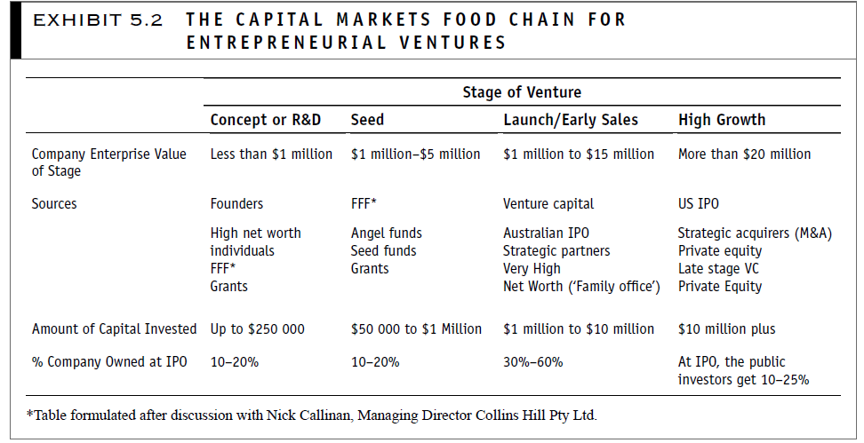
Crowdfunding?
© McGraw-Hill Australia Pty Ltd 2011
PowerPoint slides for New Venture Creation: Entrepreneurship for the 21st Century (A Pacific Rim Focus) by Timmons et al.
5-9

Slide 10


When is an Idea an Opportunity?
Create or add significant value to a customer or end user.
Solve a significant problem, remove a serious pain point, or meeting a significant want or need.
Have a robust market, margin and moneymaking characteristics.
Share a good fit with founder(s) and management team at the time and marketplace – long with an attractive risk-reward balance.
© McGraw-Hill Australia Pty Ltd 2011
PowerPoint slides for New Venture Creation: Entrepreneurship for the 21st Century (A Pacific Rim Focus) by Timmons et al.
5-10

Slide 11
The Real World
Opportunities are:
  Created
  Built
  Using:
    Ideas
    entrepreneurial creativity
e.g. Haier washing machine washing clothes and potatoes
© McGraw-Hill Australia Pty Ltd 2011
PowerPoint slides for New Venture Creation: Entrepreneurship for the 21st Century (A Pacific Rim Focus) by Timmons et al.
5-11

Slide 12
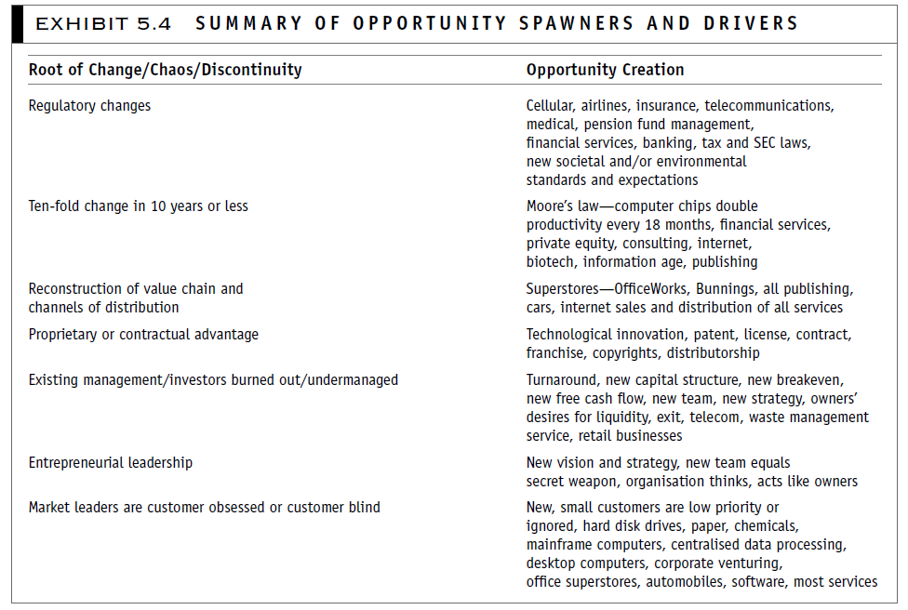
© McGraw-Hill Australia Pty Ltd 2011
PowerPoint slides for New Venture Creation: Entrepreneurship for the 21st Century (A Pacific Rim Focus) by Timmons et al.
5-12

Slide 13
The Role of Ideas
A good idea is the first step in the entrepreneurial process.
But it is simply a tool which creativity then shapes into an opportunity.
© McGraw-Hill Australia Pty Ltd 2011
PowerPoint slides for New Venture Creation: Entrepreneurship for the 21st Century (A Pacific Rim Focus) by Timmons et al.
5-13

Slide 14
Opportunity Recognition
Possessing information necessary to identify an opportunity.
Cognitive style necessary to exploit opportunity.
Role of context in mediating both.
© McGraw-Hill Australia Pty Ltd 2011
PowerPoint slides for New Venture Creation: Entrepreneurship for the 21st Century (A Pacific Rim Focus) by Timmons et al.
5-14

Slide 15
The Experience Factor
Experience vital in looking at new venture ideas.
Ability to recognise a pattern and opportunity while it is still taking shape ‘pattern recognition’.
© McGraw-Hill Australia Pty Ltd 2011
PowerPoint slides for New Venture Creation: Entrepreneurship for the 21st Century (A Pacific Rim Focus) by Timmons et al.
5-15

Slide 16
Enhancing Creative Thinking
Used in recognising opportunities.
Can be learned or enhanced.
Living/thinking tends to be defined by others/institutions.
Impact of social pressures.
© McGraw-Hill Australia Pty Ltd 2011
PowerPoint slides for New Venture Creation: Entrepreneurship for the 21st Century (A Pacific Rim Focus) by Timmons et al.
5-16

Slide 17
Brainstorming Rules
Define your purpose.
Choose participants.
Choose a facilitator.
Brainstorm spontaneously, copiously.
No criticisms, no negatives.
© McGraw-Hill Australia Pty Ltd 2011
PowerPoint slides for New Venture Creation: Entrepreneurship for the 21st Century (A Pacific Rim Focus) by Timmons et al.
5-17

Slide 18
Brainstorming Rules
Record ideas in full view.
Invent to the ‘void’.
Resist becoming committed to one idea.
Identify the most promising ideas.
Refine and prioritise.
© McGraw-Hill Australia Pty Ltd 2011
PowerPoint slides for New Venture Creation: Entrepreneurship for the 21st Century (A Pacific Rim Focus) by Timmons et al.
5-18

Slide 19
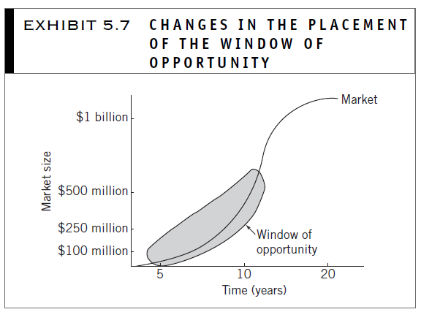
© McGraw-Hill Australia Pty Ltd 2011
PowerPoint slides for New Venture Creation: Entrepreneurship for the 21st Century (A Pacific Rim Focus) by Timmons et al.
5-19

Slide 20
© McGraw-Hill Australia Pty Ltd 2011
PowerPoint slides for New Venture Creation: Entrepreneurship for the 21st Century (A Pacific Rim Focus) by Timmons et al.
5-20

Slide 21
Screening opportunities
Criteria for evaluating venture opportunity:
  Industry and market
  Economics
  Harvest issues
  Competitive advantage issues
  Management team issues
  Personal criteria
  Strategic differentiation
© McGraw-Hill Australia Pty Ltd 2011
PowerPoint slides for New Venture Creation: Entrepreneurship for the 21st Century (A Pacific Rim Focus) by Timmons et al.
5-21

Slide 22
Screening Opportunities
Opportunity focus:
  Point of departure for screen opportunities
  NOT:
    Strategy
    Finance/spread sheet
    Company value/ownership issues
© McGraw-Hill Australia Pty Ltd 2011
PowerPoint slides for New Venture Creation: Entrepreneurship for the 21st Century (A Pacific Rim Focus) by Timmons et al.
5-22

Slide 23
Gathering Ideas (1)
Sources:
  Existing businesses
  Franchises
  Patents
© McGraw-Hill Australia Pty Ltd 2011
PowerPoint slides for New Venture Creation: Entrepreneurship for the 21st Century (A Pacific Rim Focus) by Timmons et al.
5-23

Slide 24
Gathering Ideas (2)
Product licensing
Corporations
Not for profit research institutes
Universities
© McGraw-Hill Australia Pty Ltd 2011
PowerPoint slides for New Venture Creation: Entrepreneurship for the 21st Century (A Pacific Rim Focus) by Timmons et al.
5-24

Slide 25
Industry and Trade Contracts
Customers
Distributors and wholesalers
Competitors
Former employers
Professional contacts
Consulting
Networking
© McGraw-Hill Australia Pty Ltd 2011
PowerPoint slides for New Venture Creation: Entrepreneurship for the 21st Century (A Pacific Rim Focus) by Timmons et al.
5-25

Slide 26
Shaping an Opportunity
Data about:
  Market characteristics
  Competition
  Inverse relationship between data availability and real potential of an opportunity.
© McGraw-Hill Australia Pty Ltd 2011
PowerPoint slides for New Venture Creation: Entrepreneurship for the 21st Century (A Pacific Rim Focus) by Timmons et al.
5-26

Slide 27
Issues of Data Gathering
Sorting the wheat from the chaff (or the useful from the not useful).
Conflicting information.
Reliability and validity of information.
Ethical versus legal.
Means versus ends.
How far would YOU go in the hunt for information?
© McGraw-Hill Australia Pty Ltd 2011
PowerPoint slides for New Venture Creation: Entrepreneurship for the 21st Century (A Pacific Rim Focus) by Timmons et al.
5-27

Slide 28
Sources
Guides and company information in the public domain.
Internet (issues of validity and reliability of sites).
Journal articles (includes all media not just academic sources).
Statistics (but remember ‘lies, damned lies, and statistics’).
© McGraw-Hill Australia Pty Ltd 2011
PowerPoint slides for New Venture Creation: Entrepreneurship for the 21st Century (A Pacific Rim Focus) by Timmons et al.
5-28

Slide 29
Other Sources
Trade associations
Employees
Consulting firms
Market research firms
Key members of the supply/value chain
Public filings
Networks
Other
© McGraw-Hill Australia Pty Ltd 2011
PowerPoint slides for New Venture Creation: Entrepreneurship for the 21st Century (A Pacific Rim Focus) by Timmons et al.
5-29

